Slide 1

Highly available, causally ordered group chat
Francesco Spangaro – Giacomo Orsenigo – Federico Saccani

Slide 2


Network
Peer to peer connection with a discovery server
Using Java TCP sockets
Acks to detect network failures
10734844 - 10710031 - 10700471

Slide 3



Connection setup
The new peer asks the discovery server for the list of addresses.
The new peer establishes connections with all other peers.
10734844 - 10710031 - 10700471

Slide 4

Chat creation
A
B
Chat name:
<empty>
Chat name
Set<User>
Chat name:
<empty>
Chat name
Set<User>
Chat name:
<empty>
C

Slide 5
Sending a message (without network faults)
A
B
Chat 1:
Message 1
Chat 1:
Message 1
Message 1
Chat 1
Message 1
Chat 1
Chat 1:
Message 1
C

Slide 6
Network faults
All packets are acknowledged to detect network faults
A
B
All packets sent during network fault are enqueued
Automatically retry to reconnect
When reconnected send enqueued packets
C

Slide 7
Sending a message (example of network fault)
Resend queue:
B -> Message 1 (chat 1)
A
B
Chat 1:
Message 1
Message 1
Chat 1
Message 1
Chat 1
Chat 1:
Message 1
C

Slide 8
Sending a message (example of network fault)
Resend queue:
B -> Message 1 (chat 1)
A
B
Chat 1:
Message 1
Message 2
Message 2
Chat 1
C
Chat 1
Chat 1:
Message 1

Slide 9
Sending a message (example of network fault)
Resend queue:
B -> Message 1 (chat 1)
A
Chat 1:
Message 1
Message 2
B
Queued messages:
Message 2
Chat 1:
Message 1
Message 2
Message 1
Chat 1
When the network recovers
Chat 1:
Message 1
Message 2
All messages are recevived in the correct order
C

Slide 10
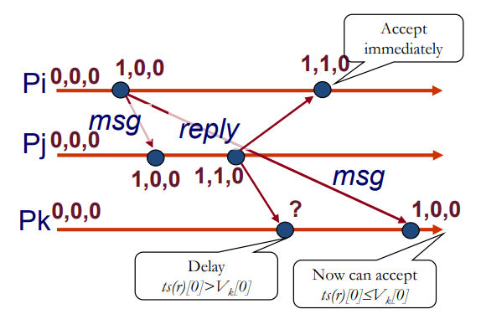
Vector clocks for causal delivery
Order between messages and replies is preserved
Increment personal clock only when sending a message
On message reception check the clocks
Hold a message until all previous messages are received:
ts(r)[j] = Vk[j]+1
ts(r)[i] ≤ Vk[i] ∀ i ≠ j
If there are no previous messages accept the message and merge the clocks

Slide 11
Sending a message (code)
public Message send(String msg, String sender) { try { pushLock.lock(); vectorClocks.put(sender, vectorClocks.get(sender) + 1); Message m = new Message(msg, Map.copyOf(vectorClocks), sender); msgList.add(m); propertyChangeSupport.firePropertyChange( … ); return m; } finally { pushLock.unlock(); } }
Only one message at the time can be add to a chat
Increment the sender's clock
Create the message with updated clocks
Update GUI

Slide 12
Checking vector clocks on reception (code)
Check if one entry in the vector clock map has increased
private int checkVC(Message m) { Map<String, Integer> newClocks = Map.copyOf(m.vectorClocks()); boolean senderFound = false; for (String u : users) { if (newClocks.get(u) == vectorClocks.get(u) + 1 && !senderFound){ senderFound = true; } else if ((newClocks.get(u) > vectorClocks.get(u))) { return -1; } } if (!senderFound) return 0;
return 1; }
The first entry that is increased by 1, we assume it's the sender
If any other entry has increased, or if any entry has increased more than 1, enqueue the message
If no clocks incremented, drop the message
Accept the message

